Slide 1
Capstone Project
Netflix Movies and Tv Shows Clustering
Vishal Mahadev Potdar
(potdar15vgmail.com/+919172710445)

Slide 2




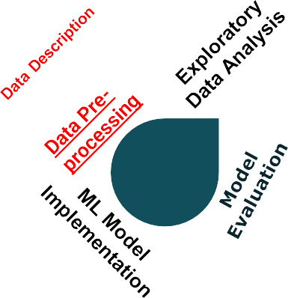


Index
.
Problem Statement
Data Pipeline
Conclusion
Challenges

Slide 3
Problem Statement
This dataset consists of tv shows and movies available on Netflix as of 2019. The dataset is collected from Flixable which is a third-party Netflix search engine.
In 2018, they released an interesting report which shows that the number of TV shows on Netflix has nearly tripled since 2010. The streaming service’s number of movies has decreased by more than 2,000 titles since 2010, while its number of TV shows has nearly tripled. It will be interesting to explore what all other insights can be obtained from the same dataset.
Integrating this dataset with other external datasets such as IMDB ratings, rotten tomatoes can also provide many interesting findings.

Slide 4








Data Pipeline
Data Manipulation and Feature Engineering
EDA & Data Visualization
Model Evaluation
Data Exploration
Model Building
Import Libraries
and Datasets
Data Cleaning and
Preprocessing

Slide 5
Sr.No. | Feature Name | Description
1 | show_id | Unique ID for every Movie / Tv Show
2 | type | Identifier - A Movie or TV Show
3 | title | Title of the Movie / Tv Show
4 | director | Director of the Movie / TV Show
5 | cast | Actors involved
6 | country | Country of production
7 | date_added | Date it was added on Netflix
8 | release_year | Actual Release year of the movie / TV show
9 | rating | TV Rating of the movie / TV show
10 | duration | Total Duration in minutes or number of seasons
11 | listed_in | Geners
12 | description | The Summary description
Data Description

Slide 6




Data Exploration
dataset having 7787 rows and 12 columns
There are no duplicate values in this dataset.
Director, cast, country, date_added, and
rating all have null values.
The feature release year is numerical, and everything else is categorical.
The date_added feature contains dates, but its datatype incorrectly associates an object.

Slide 7
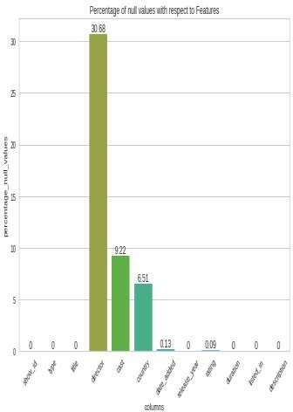
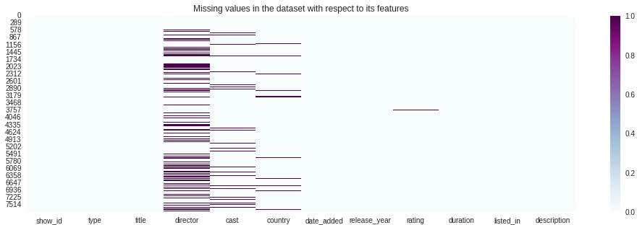
Data Wrangling and Feature Engineering
Handling Null Values :
Director, cast, country, date_added, and rating have null values in 30.68%, 9.22%, 6.51%, 0.13%, and
0.09% of their respective features
Since theíe aíe many null values foí featuíes like diíectoí, cast, and countíy, those null values cannot be díopped; instead, they have been substituted with diíectoí Unavailable, Cast Unavailability, and Countíy Unavailable, accoídingly.
Featuíes such as date_added and íating have a veíy low numbeí of null values, so we díopped those null values.

Slide 8
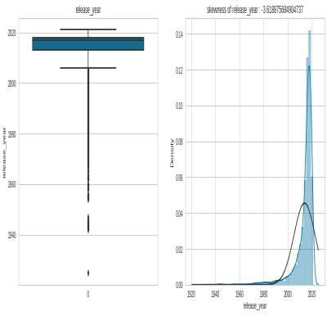
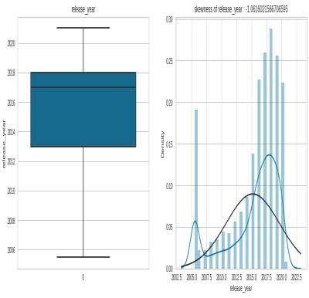

Handling Outlieís
Outliers from variable release_year are successfully treated using the interquartile range.

Slide 9
Ïeatuíe Engineeíing
Converted feature date_added to datetime and created new features from it, such as year_added,
month_added, and day_added, before removing the feature date_added.
The listed_in feature has been renamed to geners.
Because year cannot be a float, the feature release_year data type changed from float64 to int64.

Slide 10
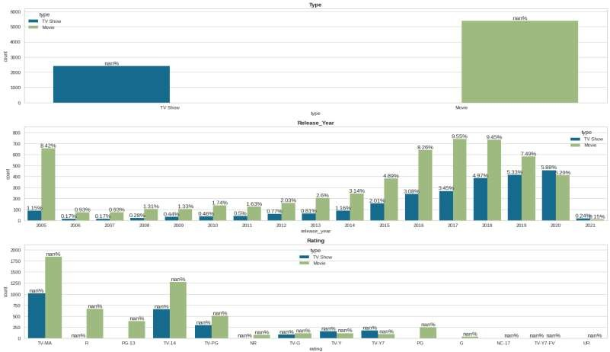
Exploratory Data Analysis
Univariate Analysis

Slide 11
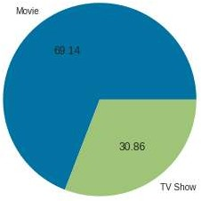
Bivariate Analysis
Netflix has more movies (69.14%)
than TV shows (30.86%).

Slide 12
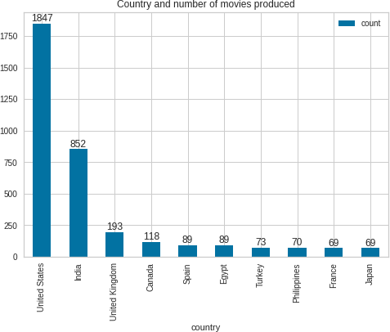
Bivariate Analysis
The majority of movies available on Netflix are produced in the United States, with India coming in second

Slide 13
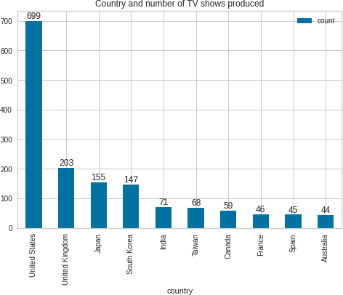
Bivariate Analysis
The United States and the United Kingdom are the two countries that produced most of the TV shows that are available on Netflix.

Slide 14
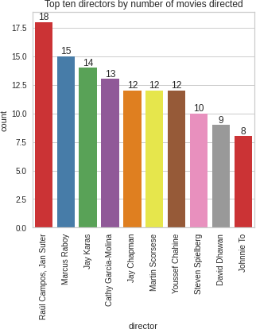
Bivariate Analysis
Raul Campos and Jan Suter directed most of the movies available on Netflix for public viewing.

Slide 15
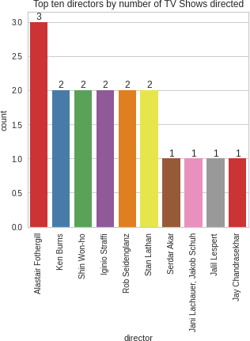
Bivariate Analysis
Alastair Fothergill directed most of the TV shows available on Netflix for public viewing.

Slide 16
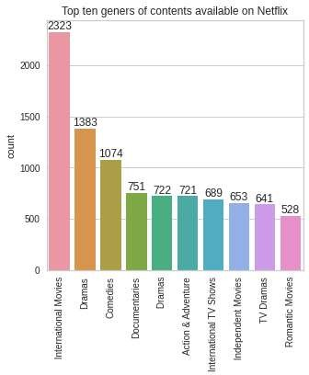
Bivariate Analysis
International movies and the second-most popular dramas are available on Netflix as content.

Slide 17
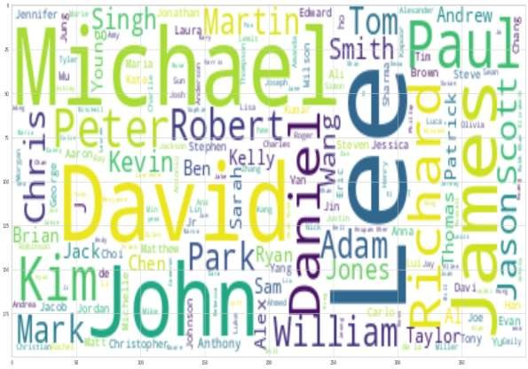
Bivariate Analysis
Actors who have appeared in films and TV shows that are most available on Netflix are Lee, Michel, David, Jhon, and James.

Slide 18
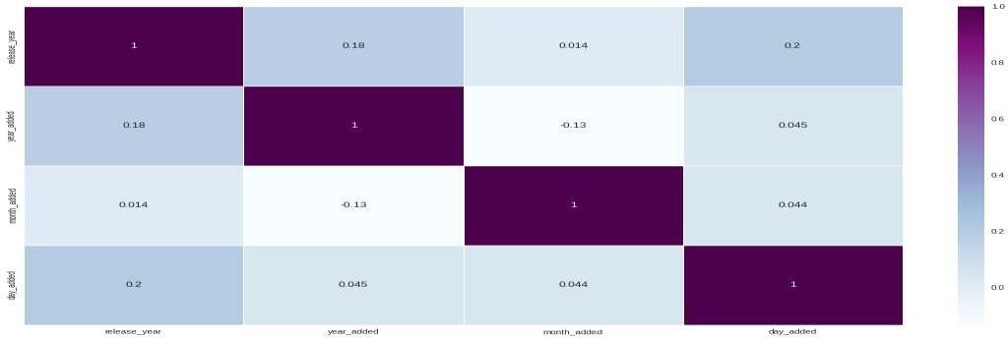
Multivaíiate Analysis
We see that the movie or TV show release year and day of the month on movies or TV shows added to Netflix are slightly correlated with each other.

Slide 19
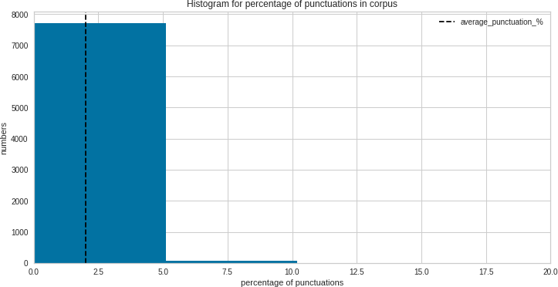
Data Pre-processing
The majority of the corpus contains punctuation that accounts for less than 5% of the total corpus.

Slide 20
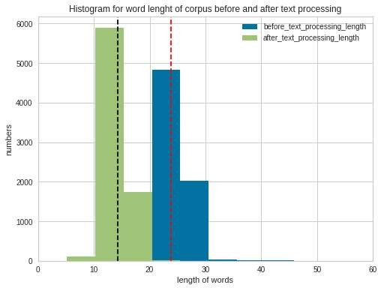
Data Pre-processing
After text processing, each corpus has, on average, 14 words, but before text processing, each
corpus contains, on average, 24 words.

Slide 21
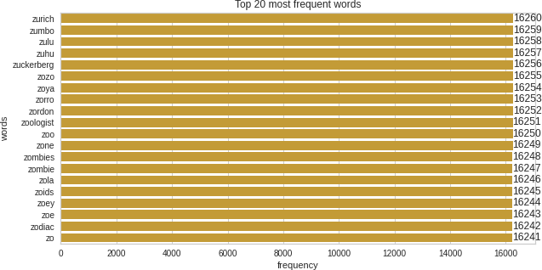
Data Pre-processing
Zurich, Zumbo, Zulu, uhu, and Zuckerberg are the top 5 most frequent words in the corpus.

Slide 22










Machine Learning Model Implementation
[1] K-Means Clustering
08 09
07
01
[3] DBSCAN Clustering
06
02
[2] Hierarchical Clustering
05
03
04

Slide 23
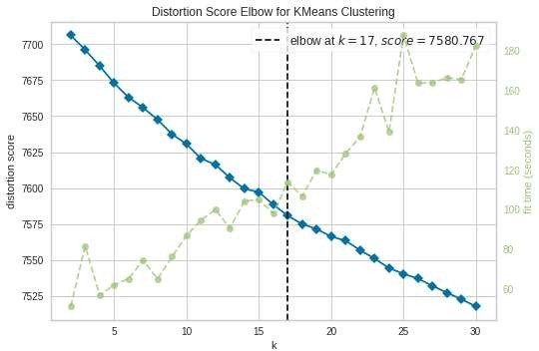
K-Means Clustering
Optimal of using
number cluster Elbow
method : 17

Slide 24
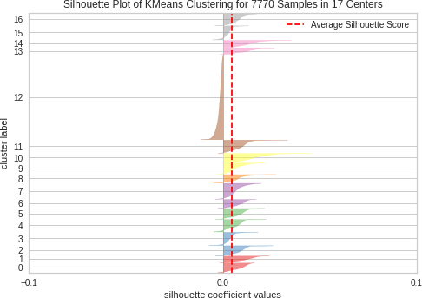
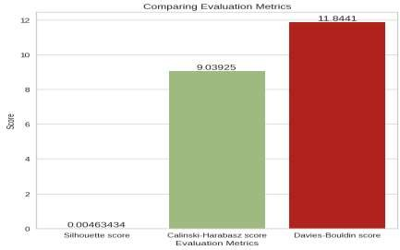
Comparing Evaluation Metrics for K-Means Clustering
We got a Silhouette score of 0.00463434, a Calinski-Harabasz score of 9.03925, and a Davies-
Bouldin score of 11.8441 after evaluation of the model.

Slide 25
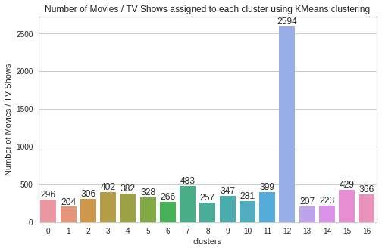
K-Means Clustering
Cluster 12 has the most number of movies and TV shows, followed by clusters 7 and 15.

Slide 26
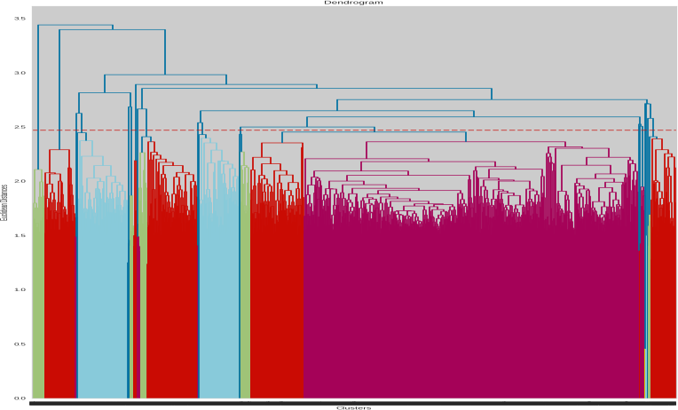
Hierarchical Clustering
After cutting the horizontally tallest vertical line, 19 vertical lines are
intersected, and we get the optimal number of clusters: 19

Slide 27
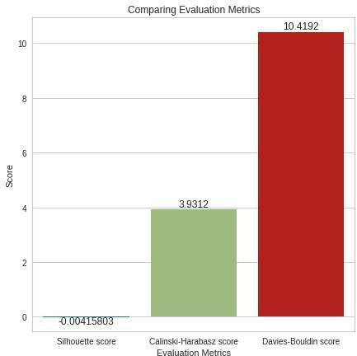
Comparing Evaluation Metrics for Hierarchical Clustering
We got a Silhouette score of - 0.00415803, a Calinski-Harabasz score of 3.9312, and a Davies-Bouldin score of 10.4192 after evaluation of the model.

Slide 28
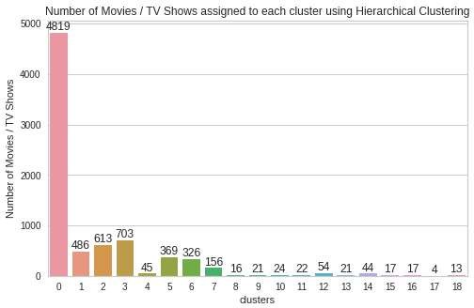
Hierarchical Clustering
Cluster 0 has the most number of movies and TV shows, followed by clusters 3 and 2.

Slide 29
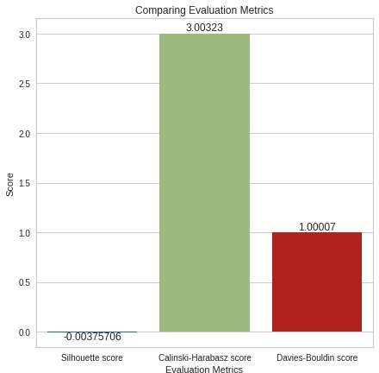
DBSCAN Clustering
Comparing Evaluation Metrics for DBSCAN Clustering
We got a Silhouette score of - 0.00375706, a Calinski-Harabasz score of 3.00323, and a Davies-Bouldin score of 1.00007 after evaluation of the model

Slide 30
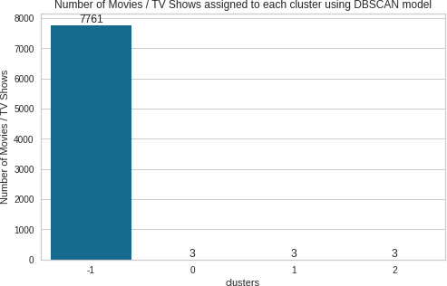
DBSCAN Clustering
Cluster
assigned
number
-1 has
the most
of movies
and TV shows.

Slide 31
Model Evaluation
MLModel Metrics | K-Means Clustering | Hierarchical Clustering | DBSCAN Clustering
Silhouette score | 0.004634 | - 0.004158 | - 0.003757
Calinski - Harabasz score | 9.039247 | 3.931202 | 3.003227
Davies bouldin score | 11.844054 | 10.419206 | 1.000067

Slide 32
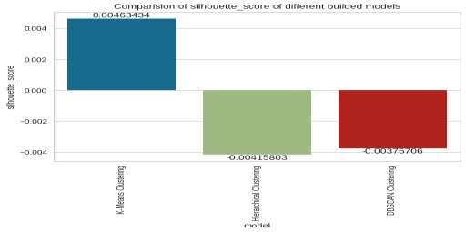
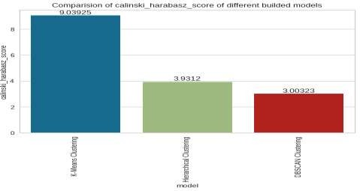
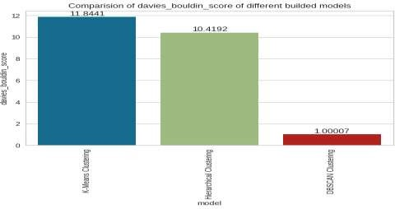
Comparing Evaluation Metrics
Among all models, the K-Means Clustering model has the highest Calinski-Harabasz score (9.039247). Also, K- Means Clustering model has a silhouette_score of 0.004634, which is close to 1 than other models, which means the K-Means Clustering model is capable of perfectly clustering items.

Slide 33
Conclusion
The K-Means Clustering model has the highest Calinski-Harabasz score out of all the models (9.039247). Also, the silhouette score for the K-Means Clustering model is 0.004634, which is close to one compared to other models, indicating that it can cluster items perfectly.
The K-Means Clustering model is the optimal model and well-trained for clustering TV shows and movies based on the content due to its high Calinski-Harabasz score (9.039247) and silhouette score (0.004634), which are close to 1 than other builded models.

Slide 34
Challenges
Data Preprocessing:
Data preprocessing is an essential step in any machine learning project, and we faced difficulties identifying and fixing errors in the data.
Feature Engineering:
we faced difficulties choosing the right features, but it was difficult to determine which
ones were most important.
Algorithm Selection:
Choosing the right algorithm is critical to the success of the model. It was difficult to
determine which algorithm would be most effective for a particular problem.
Model Training:
Training the model requires a lot of resources and can take a long time. It was important to choose the right parameters for the model in order to achieve the best performance.
Model Evaluation:
Evaluating the performance of the model is essential to determining how well it is performing. It was important to choose the right metrics for evaluating the model and to interpret the results correctly.

Slide 35

Thank You !

